Slide 1
Used Car Pricing Prediction
Jiachen Liu

Slide 2

Background
“Everybody wants their cars to be sold at an ideal price”
Pricing Model has been widely used in many fields.
We will implement car value regression model to predict the ideal price of a used car
Primary Steps:
Exploratory Data Analysis
Feature Engineering (PCA)
Classical Models (L1, L2, etc.)
Advanced Models (XGBoost)
Model Evaluation
Fun Facts:
$36.7 mil
1.6 mil
30%
Market Size
Vehicles
Demand
2020
Spring 2021
Notes:
https://www.kaggle.com/adityadesai13/used-car- dataset-ford-and-mercedes?select=audi.csv

Slide 3
Context
1
Data Source
10781
Sample Size
6
Techniques
Kaggle
BMW Dataset
Csv file
Regression Model
1
Geography
3
Categorical
6
Numerical
United Kingdom
Model, Transmission, Fuel Type
Year, Price, Mileage, Tax, Mpg, Engine Size
Notes:
https://www.kaggle.com/adityadesai13/used-car- dataset-ford-and-mercedes?select=audi.csv

Slide 4
Exploring Metadata
3 Categorical Features
Model | Car Model of the brand
Transmission | Type of gearbox
fuelType | Engine Fuel
6 Numerical Features
Year | Car Registration Year
Price | Car Price (in £)
Mileage | Distance Used
Tax | Road Tax (in £)
Mpg | Miles per gallon
engineSize | Size in liters
Used Car
Pricing Prediction
Notes:
https://www.kaggle.com/adityadesai13/used-car- dataset-ford-and-mercedes?select=audi.csv

Slide 5
Exploring Data
Sample
Model | Year | Price (in £) | Transmission | Mileage | fuelType | Tax (in £) | Mpg | engineSize (in liters)
5 Series | 2014 | 11,200 | Automatic | 67,068 | Diesel | 125 | 57.6 | 2
2 Series | 2018 | 16,250 | Manual | 10,401 | Petrol | 145 | 52.3 | 2
1 Series | 2015 | 15,499 | Semi-Auto | 20,000 | Diesel | 125 | 60.1 | 2
I3 | 2015 | 17,400 | Automatic | 29,465 | Electric | 0 | 470.8 | 1
X5 | 2016 | 34,498 | Automatic | 17303 | Hybrid | 140 | 113 | 1.5
3 Series | 2017 | 14,250 | Automatic | 55594 | Other | 135 | 148.7 | 2
M4 | 2020 | 50,000 | Semi-Auto | 700 | Petrol | 145 | 34 | 3
Industrial automation
Notes:
https://www.kaggle.com/adityadesai13/used-car- dataset-ford-and-mercedes?select=audi.csv

Slide 6



Flow Chart
EVALUATION
Result Interpretation
Future Recommendation
IMPLEMENT MODELS
Linear Regression, Elastic Net, Lasso, KNN, Ridge, XGBoost
FEATURE
ENGINEERING
Remove Missing Value
Normalize Data
PCA
EDA
MINE DATA
Data Wrangling
Data Visualization
Car Data
Source: Kaggle

Slide 7

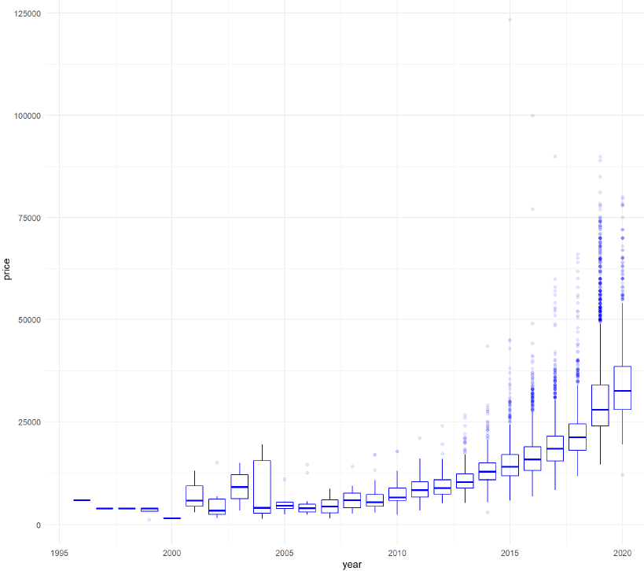
Exploratory Data Analysis
Remaining Input Variables:
Model
Year
Transmission
Mileage
fuelType
Tax
Mpg
engineSize
Target Variable: Price
Relationship between Year and Price
Notes:
https://www.kaggle.com/adityadesai13/used-car- dataset-ford-and-mercedes?select=audi.csv

Slide 8

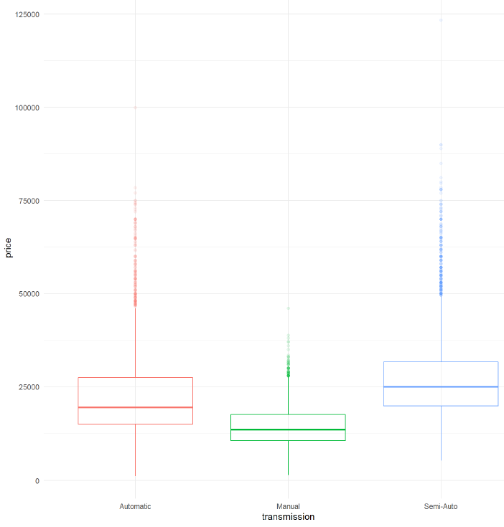
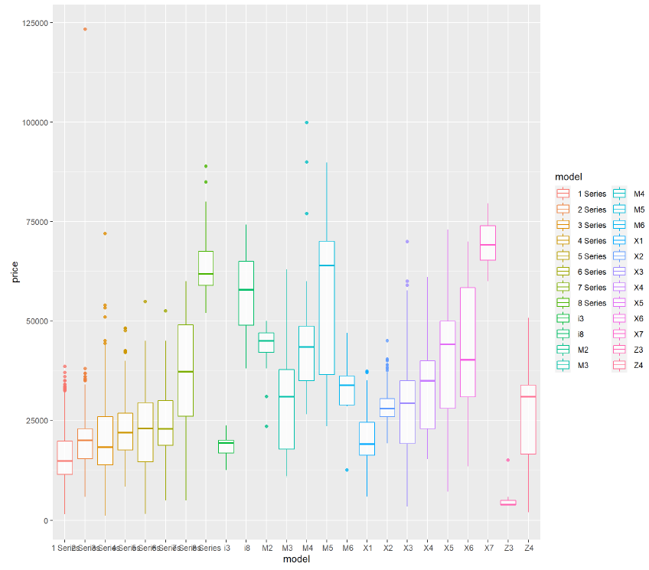
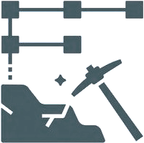
Exploratory Data Analysis
Boxplot by Transmission
Boxplot by Model
Notes:
https://www.kaggle.com/adityadesai13/used-car- dataset-ford-and-mercedes?select=audi.csv

Slide 9
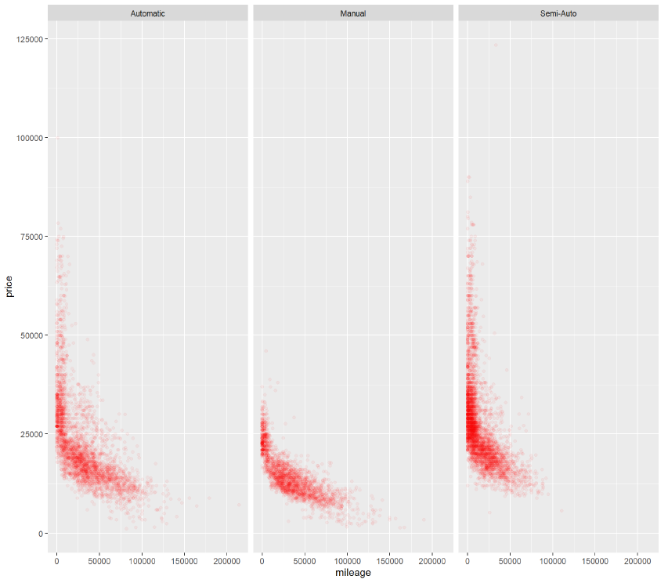
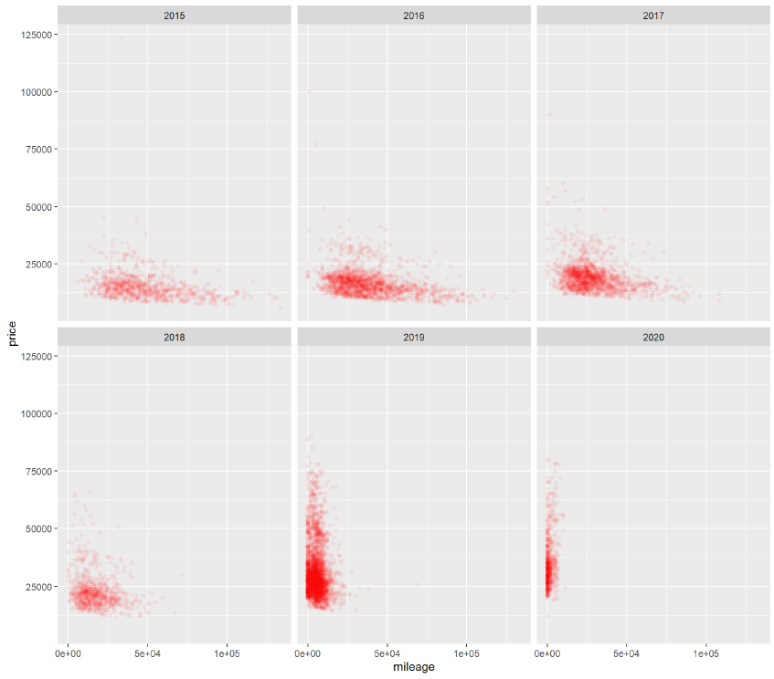

Exploratory Data Analysis
Relationship
between
mileage
and price
(Transmission)
Relationship between mileage and price (2015-2020)
Notes:
https://www.kaggle.com/adityadesai13/used-car- dataset-ford-and-mercedes?select=audi.csv

Slide 10

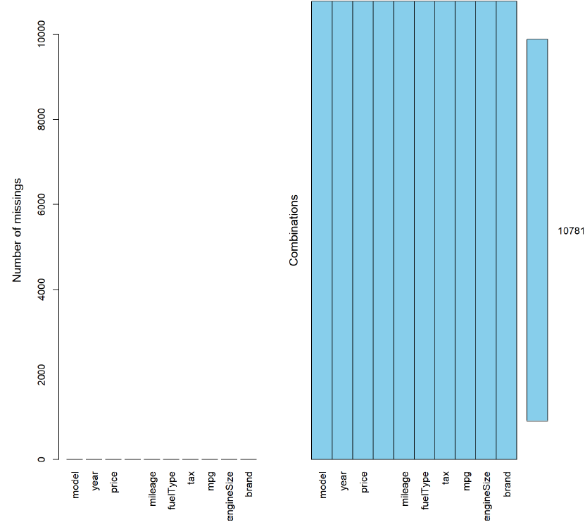
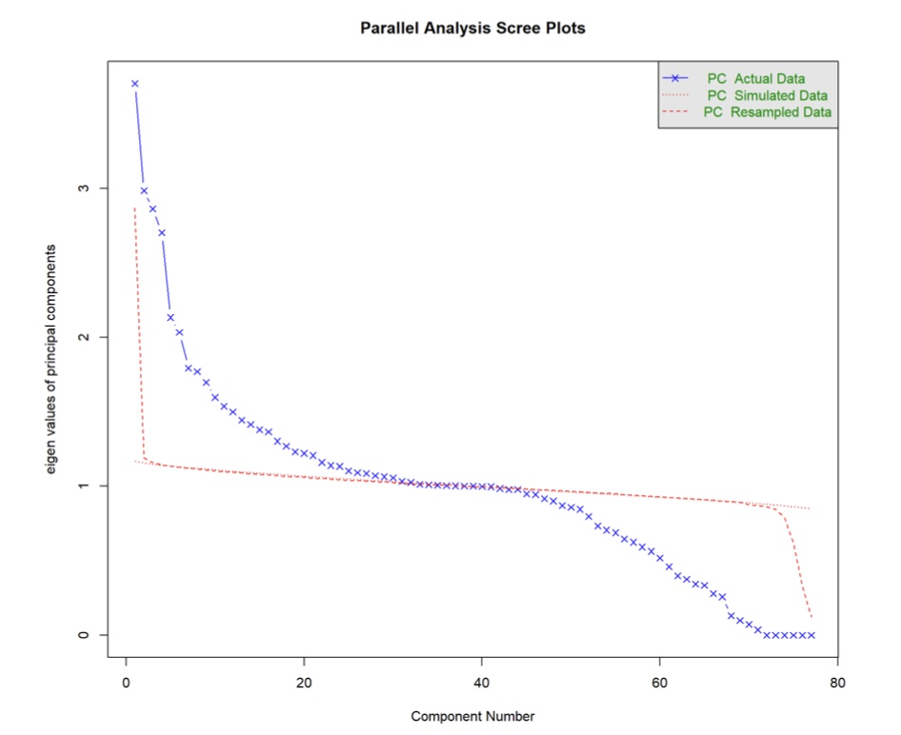
Feature Engineering
Check Missing value
Encode Categorical Data (One-Hot Encoding)
Normalize Data
Perform PCA and choose appropriate Number of Components
From these plots , we can see there is no missing value, and the number of component is 31.
Notes:
https://www.kaggle.com/adityadesai13/used-car- dataset-ford-and-mercedes?select=audi.csv

Slide 11




Model Implementation
Implement Different Regression Models
Linear Regression
Lasso Regression
Ridge Regression
Splitting Dataset
After PCA
Elastic Net
KNN
Train Dataset
80%
XGBoost
Test Dataset
20%
Notes:
https://www.kaggle.com/adityadesai13/used-car- dataset-ford-and-mercedes?select=audi.csv

Slide 12
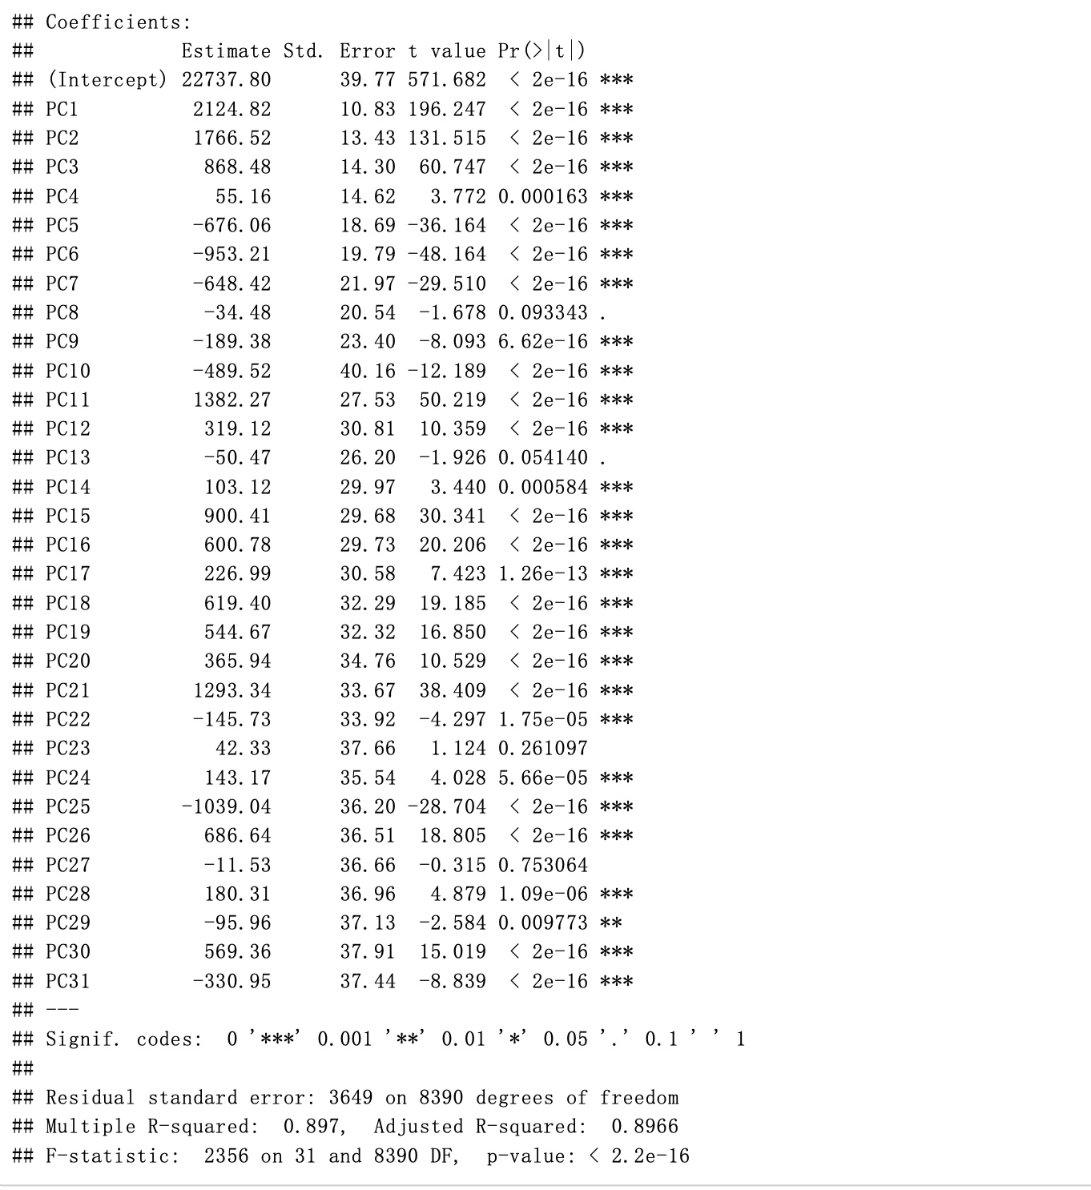
Linear Regression
Industrial automation
Notes:
https://www.kaggle.com/adityadesai13/used-car- dataset-ford-and-mercedes?select=audi.csv

Slide 13
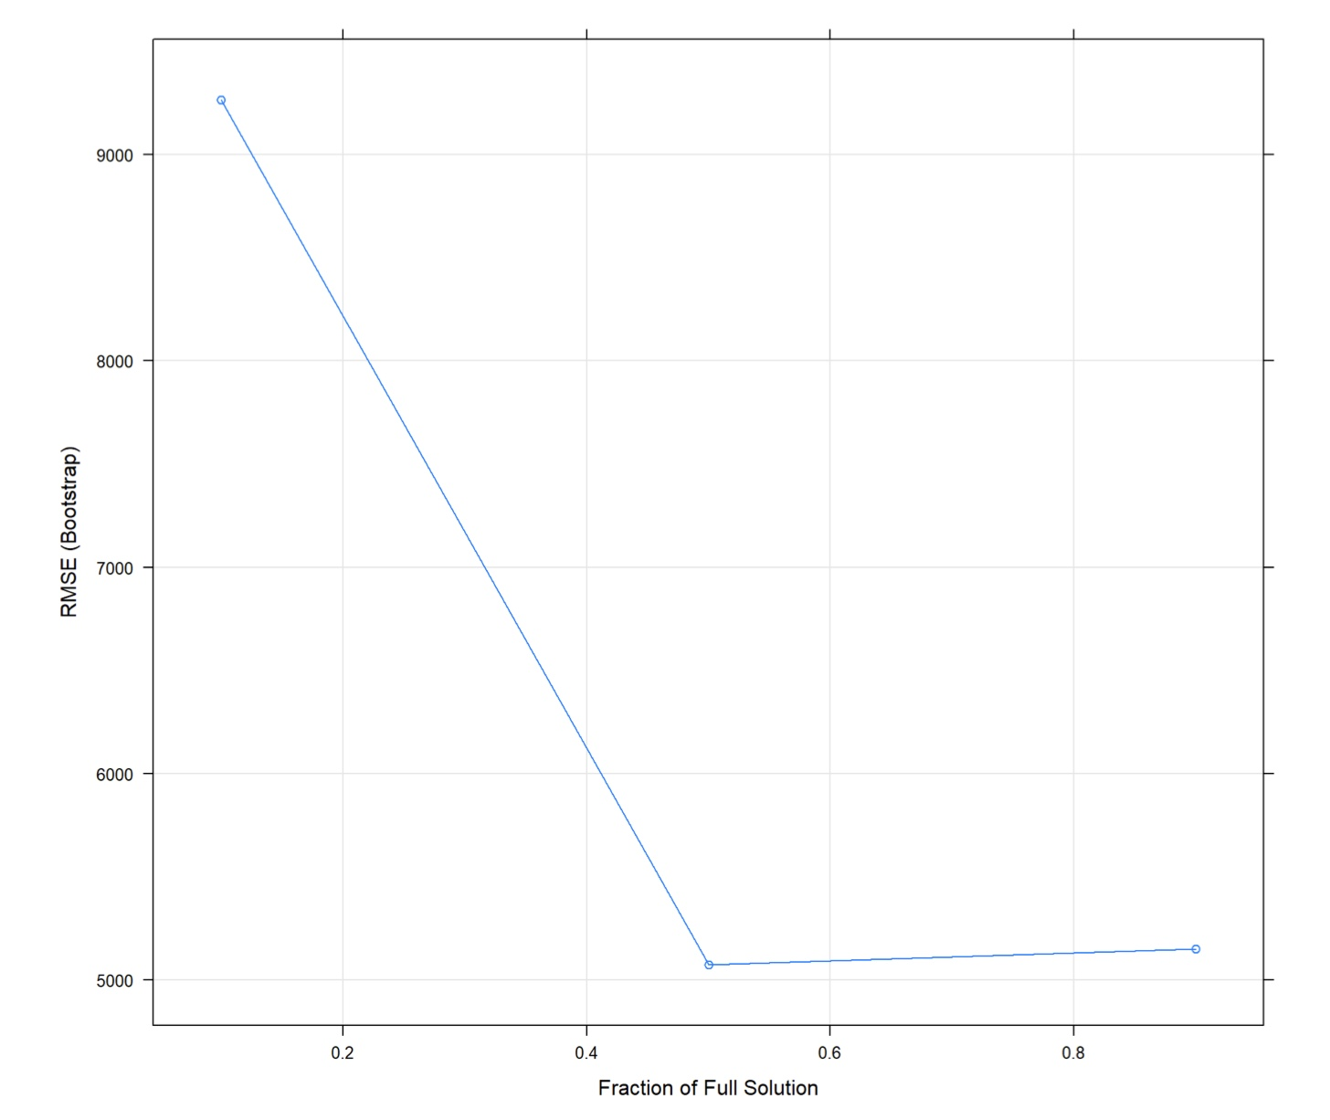
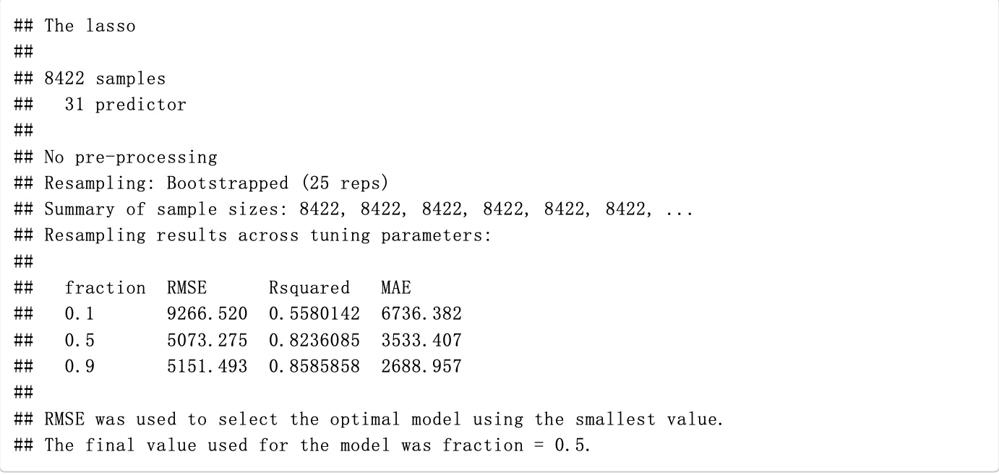
Lasso Regression
Industrial automation
Notes:
https://www.kaggle.com/adityadesai13/used-car- dataset-ford-and-mercedes?select=audi.csv

Slide 14
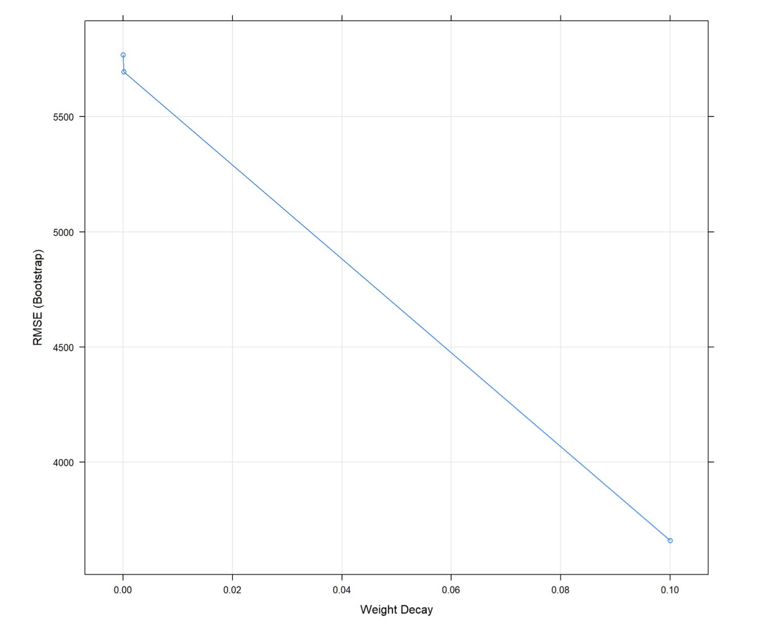
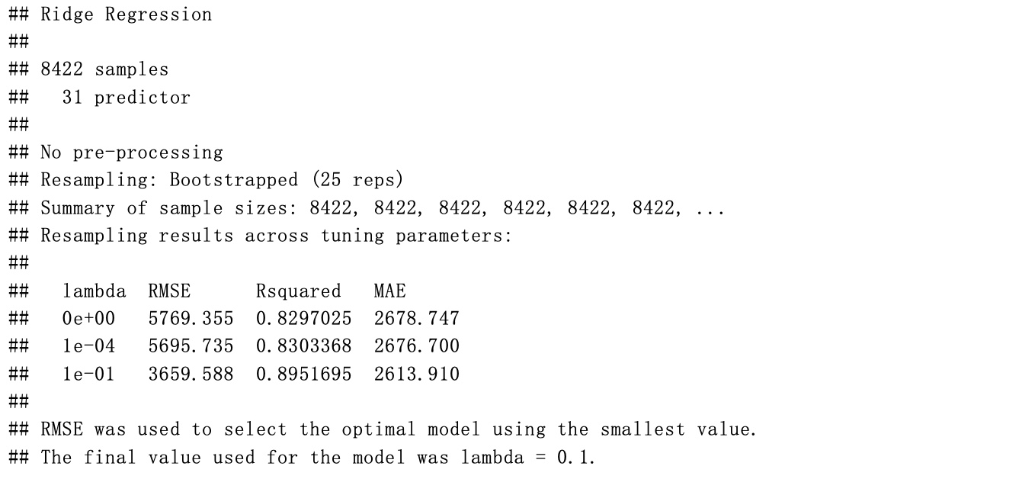
Ridge Regression
Industrial automation
Notes:
https://www.kaggle.com/adityadesai13/used-car- dataset-ford-and-mercedes?select=audi.csv

Slide 15
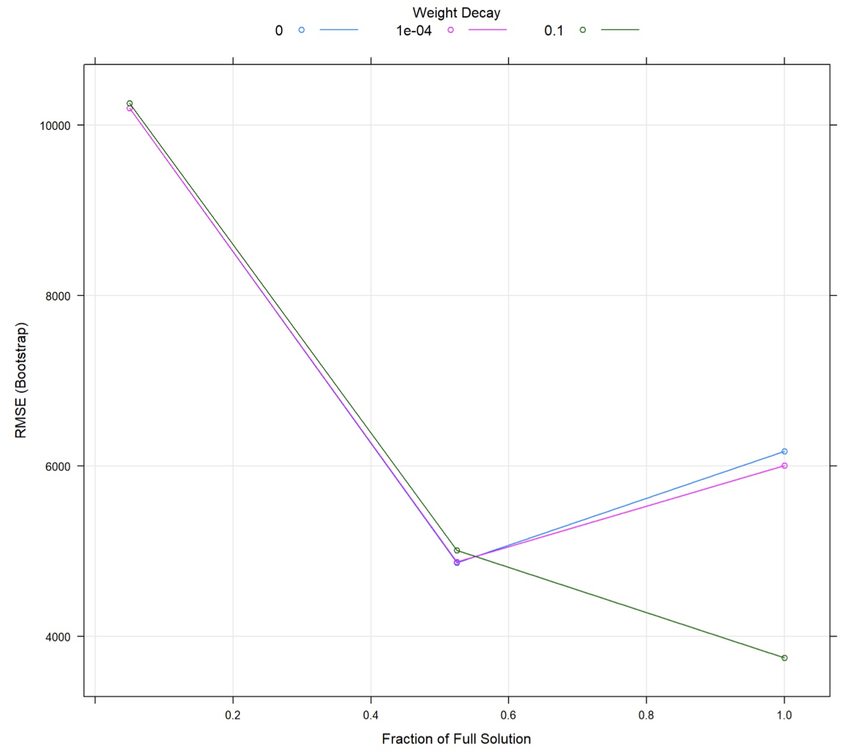
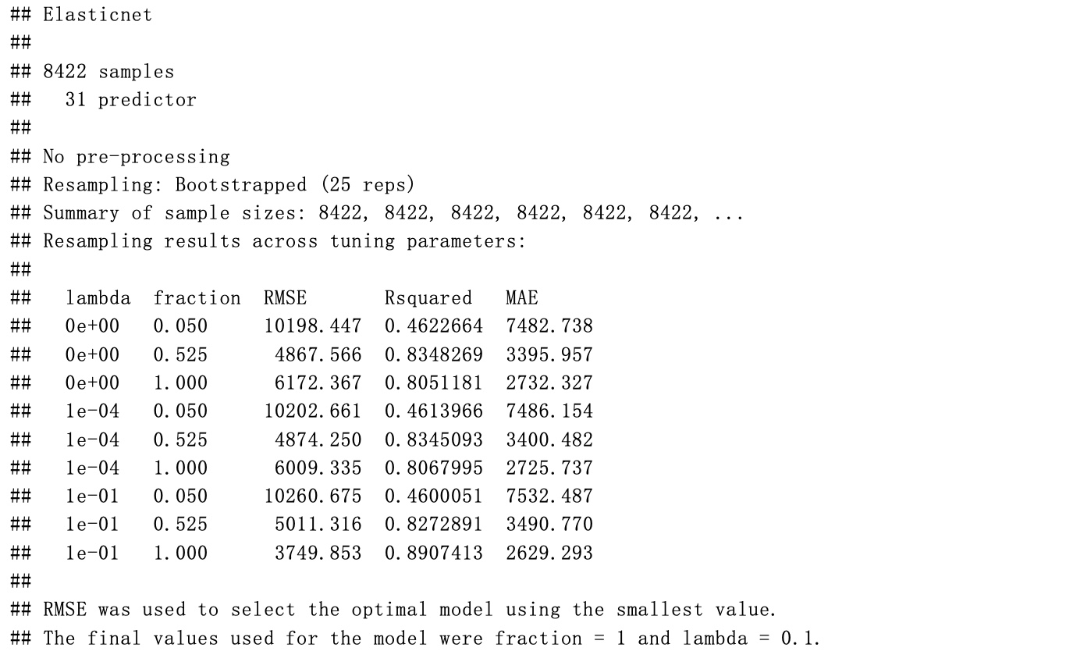
Elastic Net
Industrial automation
Notes:
https://www.kaggle.com/adityadesai13/used-car- dataset-ford-and-mercedes?select=audi.csv

Slide 16
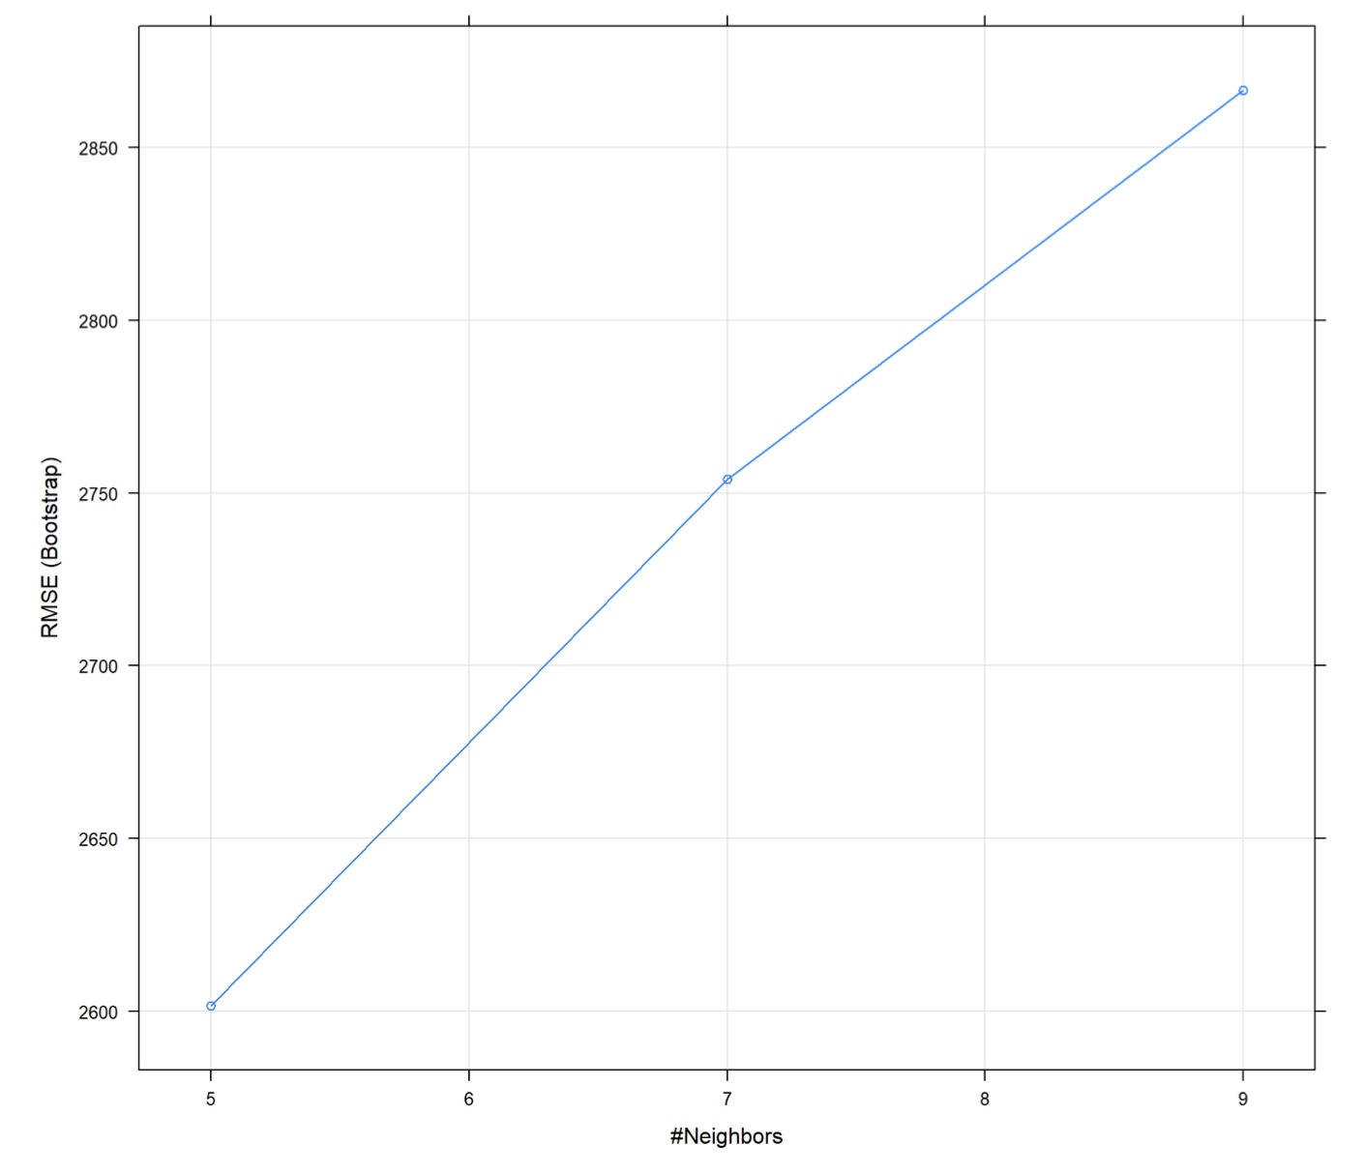
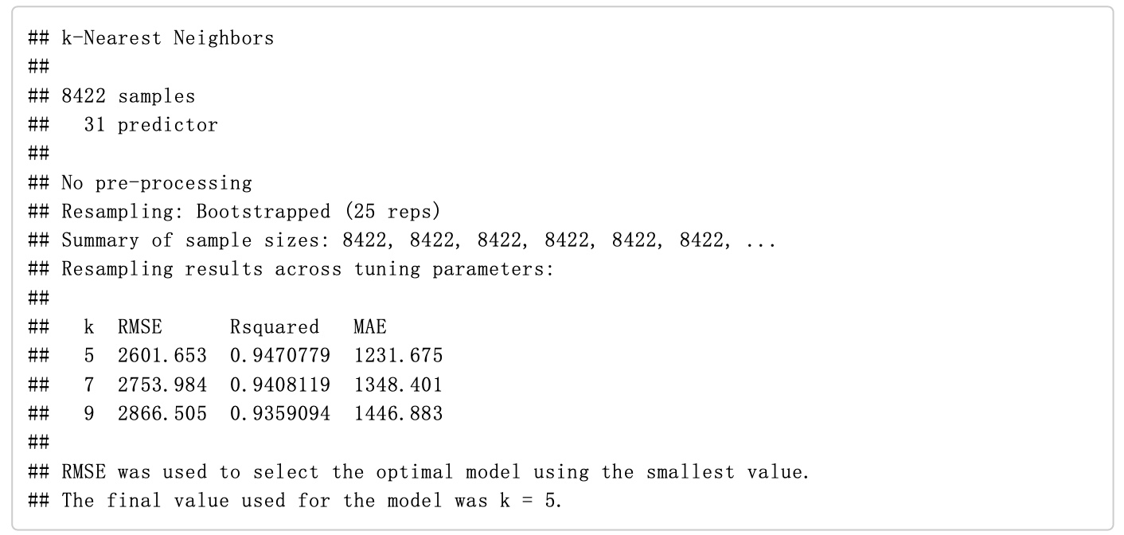
KNN Regression
Industrial automation
Notes:
https://www.kaggle.com/adityadesai13/used-car- dataset-ford-and-mercedes?select=audi.csv

Slide 17
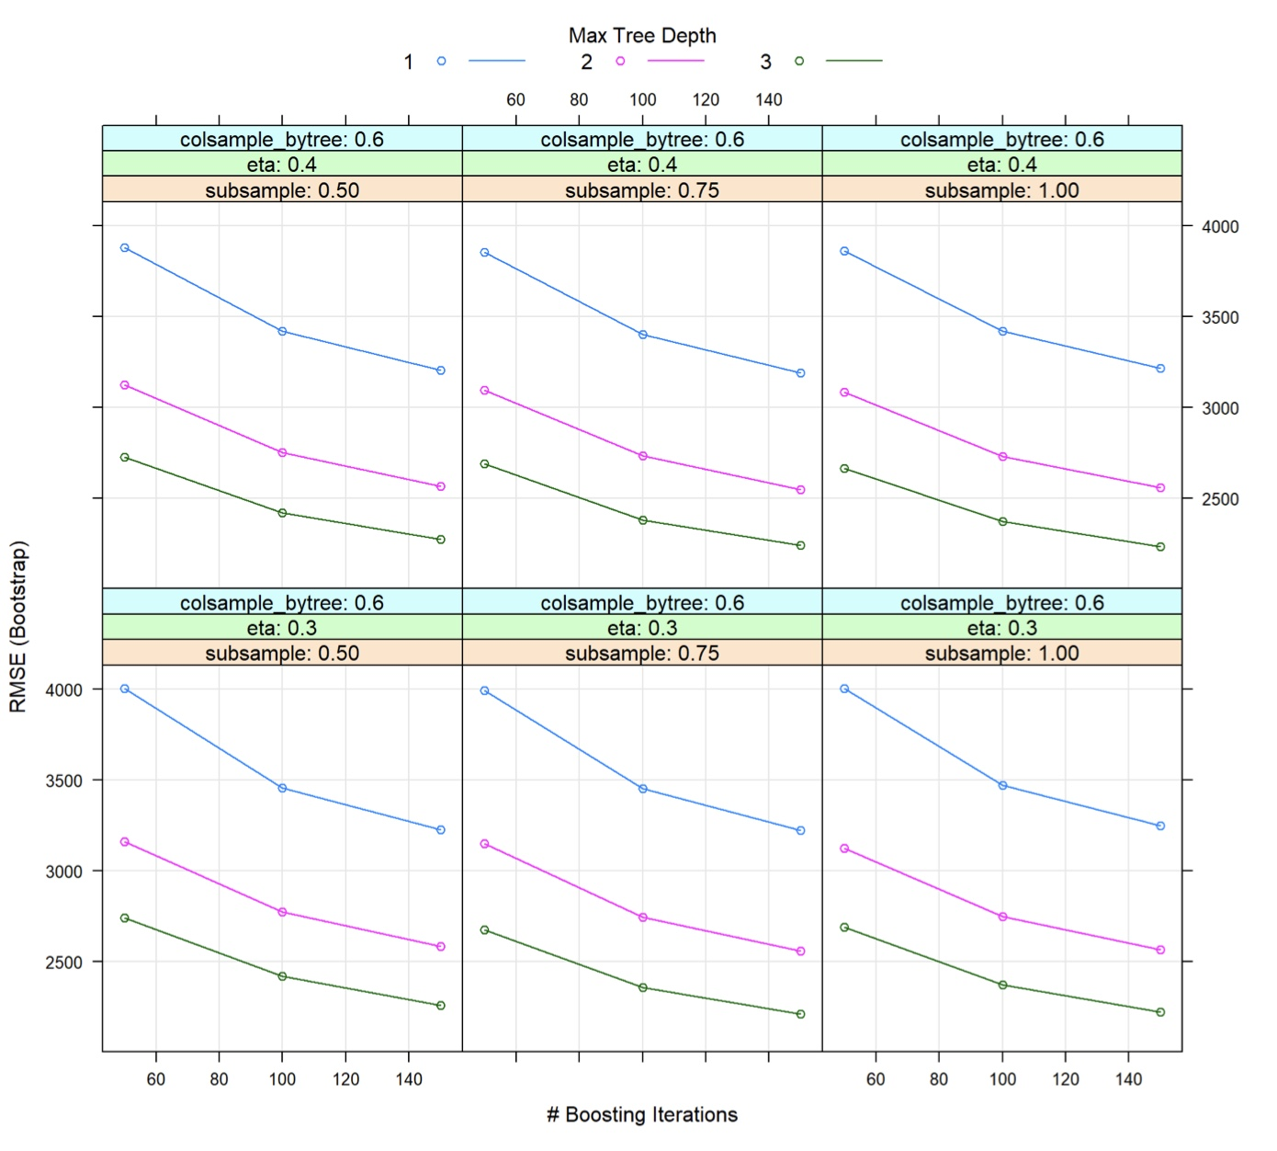
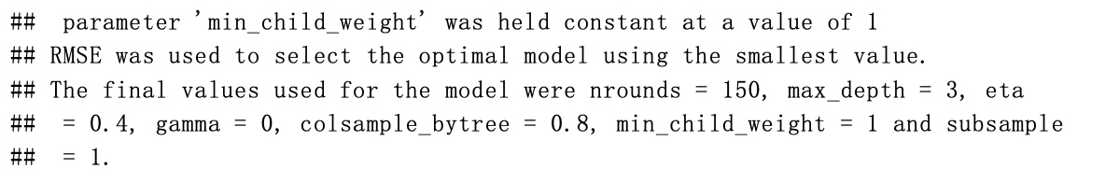
XGBoost
RMSE | R² | MAE
2133.722 | 0.9649395 | 1254.251
Industrial automation
Notes:
https://www.kaggle.com/adityadesai13/used-car- dataset-ford-and-mercedes?select=audi.csv

Slide 18
Model Evaluation
Implement each model on test set
Plot the prediction price and true price in test set
Evaluate the RMSE , R² and MAE of each model
Notes:
https://www.kaggle.com/adityadesai13/used-car- dataset-ford-and-mercedes?select=audi.csv

Slide 19
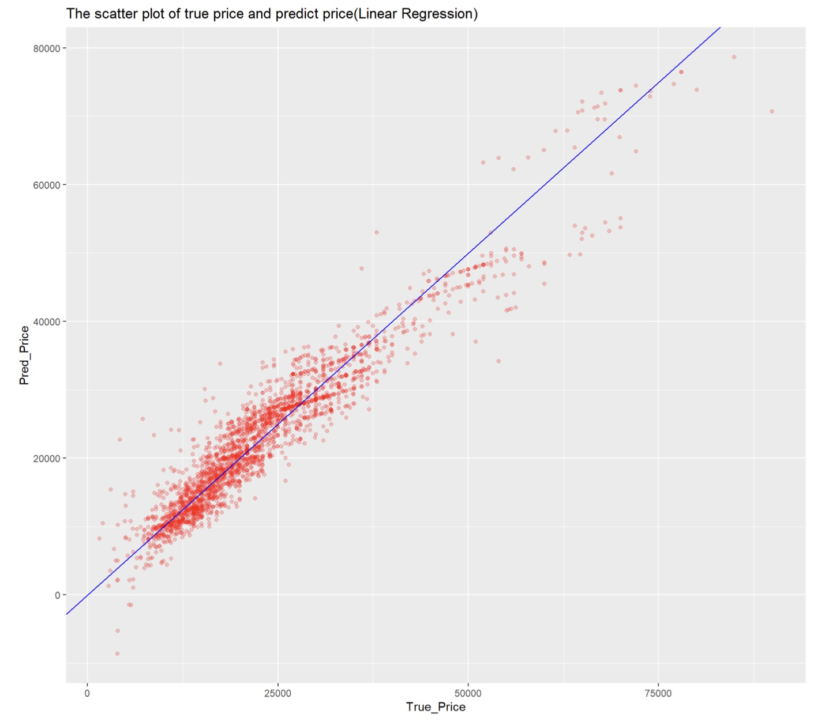
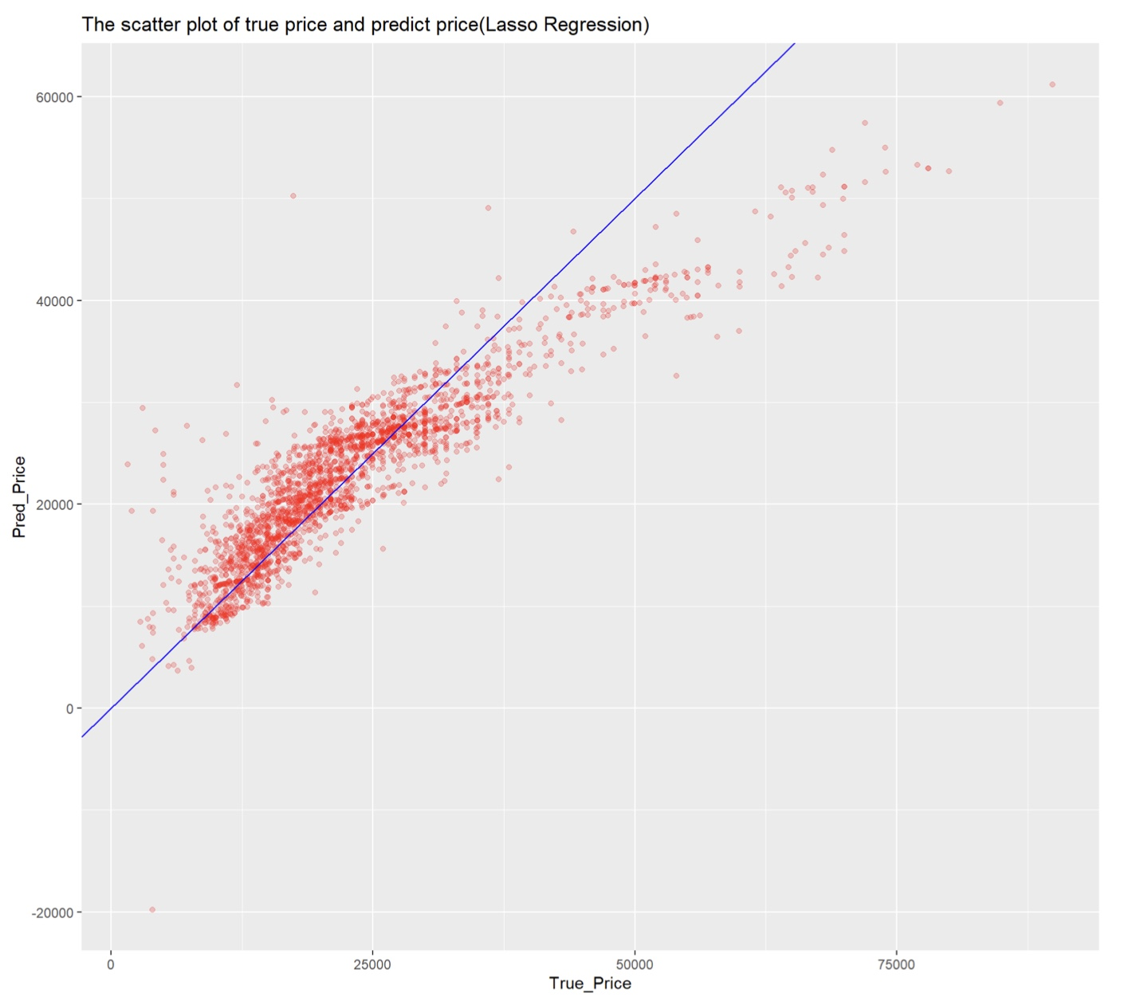
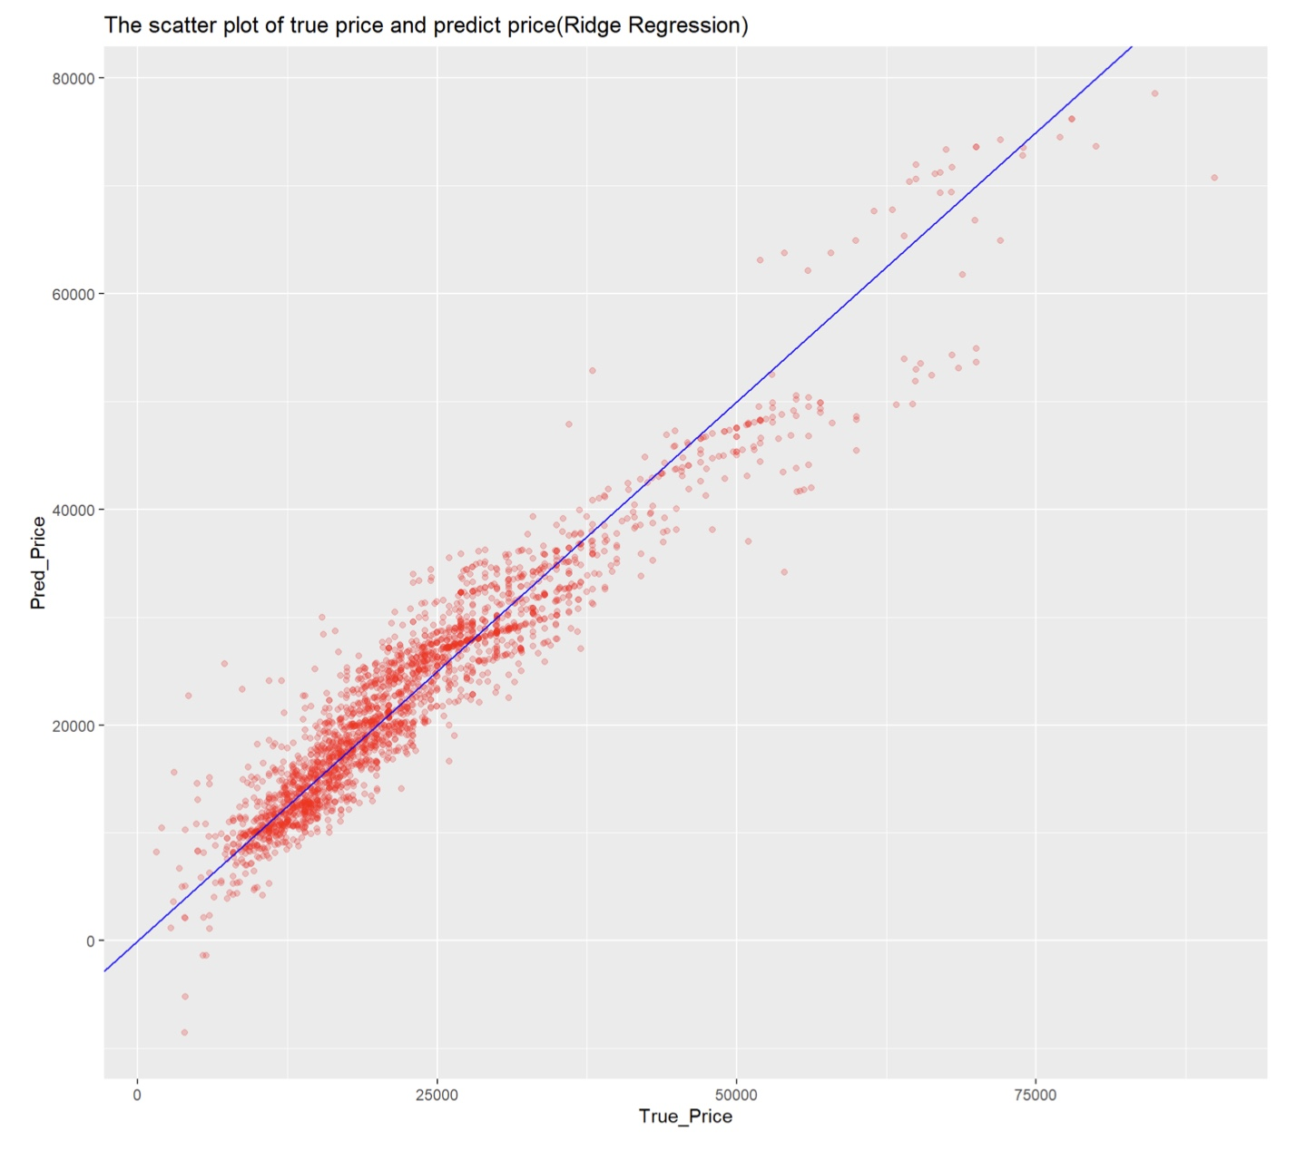

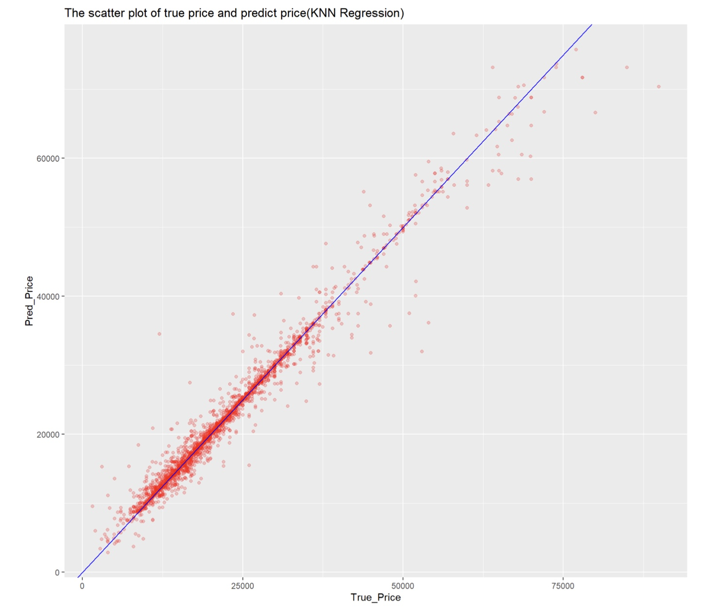
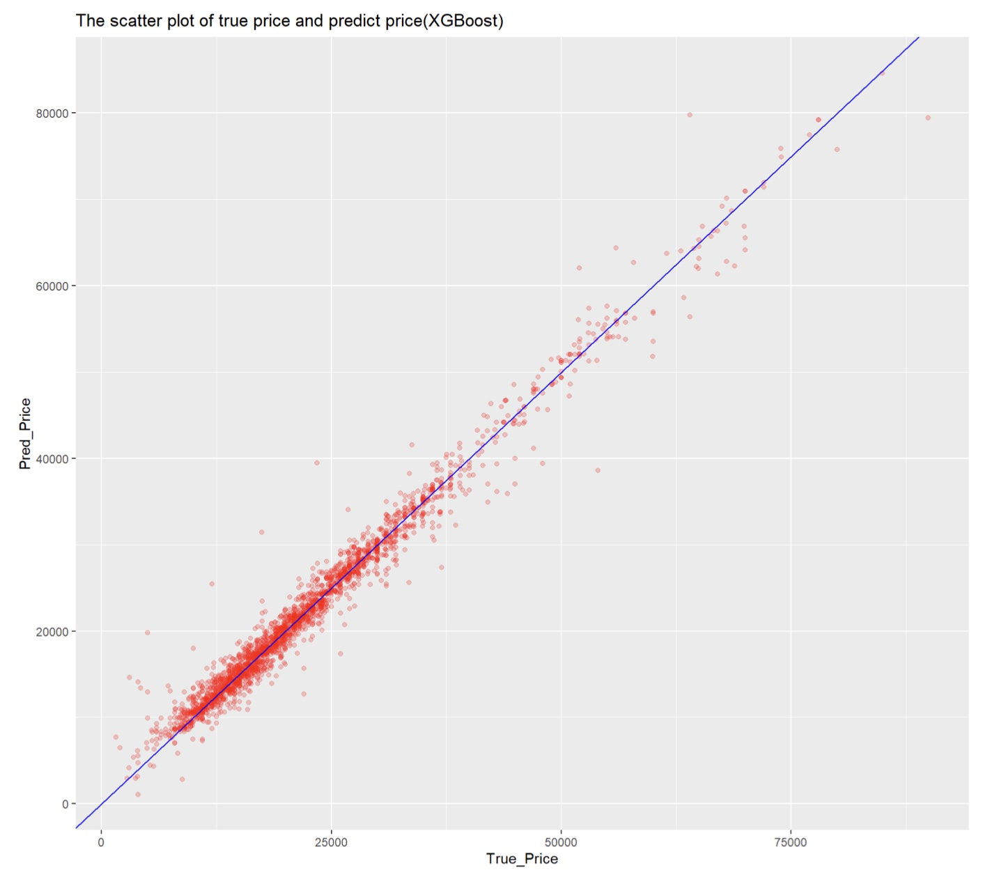
Prediction Price and True Price
 | RMSE | R² | MAE
Linear Regression | 3535.540 | 0.9081 | 2583.909
Lasso Regression | 5256.004 | 0.82924 | 3593.149
Ridge Regression | 3521.634 | 0.90883 | 2578.9292
Elastic Net | 3521.6345 | 0.90883 | 2578.9292
KNN | 2107.9561 | 0.96754 | 1056.1253
XGBoost | 1848.3558 | 0.97491 | 1179.9157
Linear Regression
Lasso Regression
Ridge Regression
Elastic Net
KNN
XGBoost
Notes:
https://www.kaggle.com/adityadesai13/used-car- dataset-ford-and-mercedes?select=audi.csv

Slide 20
Discussion
Best Model
XGBoost
R²: 97.49%
Lasso’s Underpderformance
Worst Model
Use L1 norm as penalty
L1 norm cause some feature weight to 0
Cause Overfitting
Lasso
R²: 82.92%
Notes:
https://www.kaggle.com/adityadesai13/used-car- dataset-ford-and-mercedes?select=audi.csv

Slide 21
Future Work
Try
More
Model such as Bayesian Ridge Regression
Compare
Result
Try
Between Dataset with PCA and Dataset without PCA
Other
Dimension Reduction Method such as LDA
Notes:
https://www.kaggle.com/adityadesai13/used-car- dataset-ford-and-mercedes?select=audi.csv

Slide 22
THANK YOU

